Slide 1


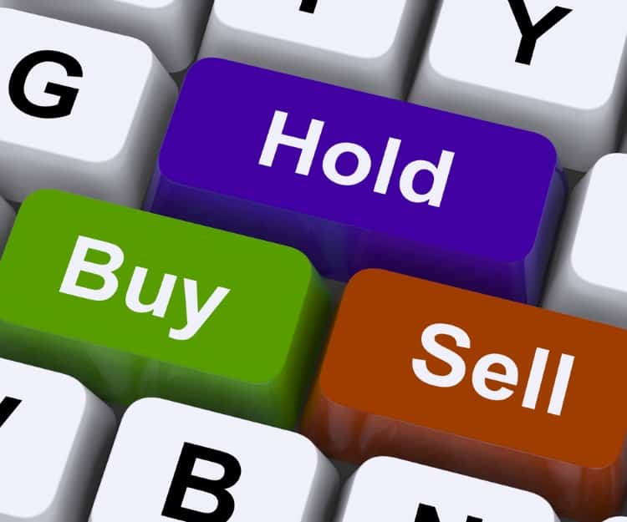
Stock Market Dashboard
Stock Market Dashboard : This project is a Streamlit-based Stock Market Dashboard that provides real-time stock data, interactive visualizations, and AI-driven insights. Users can view trends, compare stocks, and use a profit/loss calculator to make informed decisions. The platform also includes an AI chatbot for stock-related queries and an automated email sender for market updates.

Slide 2





Purpose
Make stock market data accessible to everyone
Help users analyze trends and make informed investment decisions
Provide an AI-powered assistant for real-time stock market insights
Offer a learning hub with stock market educational resources (PDFs)
Problem Addressed
Problem: Many stock market platforms are complex and difficult to use Solution: A user-friendly Streamlit dashboard for easy navigation
Problem: Lack of real-time stock insights for beginners Solution: Live stock market data & AI chatbot for quick analysis
Problem: Users struggle to predict future stock profits/losses Solution: Built-in calculator to estimate potential gains or losses
Problem: Finding reliable educational resources on stock markets Solution: Integrated PDF library with stock market learning materials
Why my project?
Easy-to-use & Beginner-Friendly – No prior stock market knowledge needed
Comprehensive Data – Real-time and historical stock market trends
AI-Powered Insights – Get smart stock suggestions with an AI chatbot
Future-Proof – Expandable with machine learning for advanced predictions
Educational Hub – Includes stock market learning PDFs for beginners
Key Functions
How to use
🔹 Live Stock Data Fetching (Yahoo Finance / Alpha Vantage API)
🔹 Interactive Graphs for trend analysis (Matplotlib, Plotly)
🔹 Stock Search & Comparison tool
🔹 Profit/Loss Calculator for future predictions
🔹 AI Chatbot for stock suggestions and Q&A
🔹 Automated Email Alerts for stock market updates
🔹 Stock Market Learning Hub (PDF library for beginners)
Login to access all functions
Visit the Website – Open the Streamlit-based web app
Search for a Stock – Enter the stock symbol to fetch real-time data
Analyze Trends – View interactive graphs and historical data
Use the Calculator – Input stock details to predict future profit/loss
Ask AI Chatbot – Get stock market insights and investment suggestions
Download PDFs – Access educational resources for learning

Slide 3
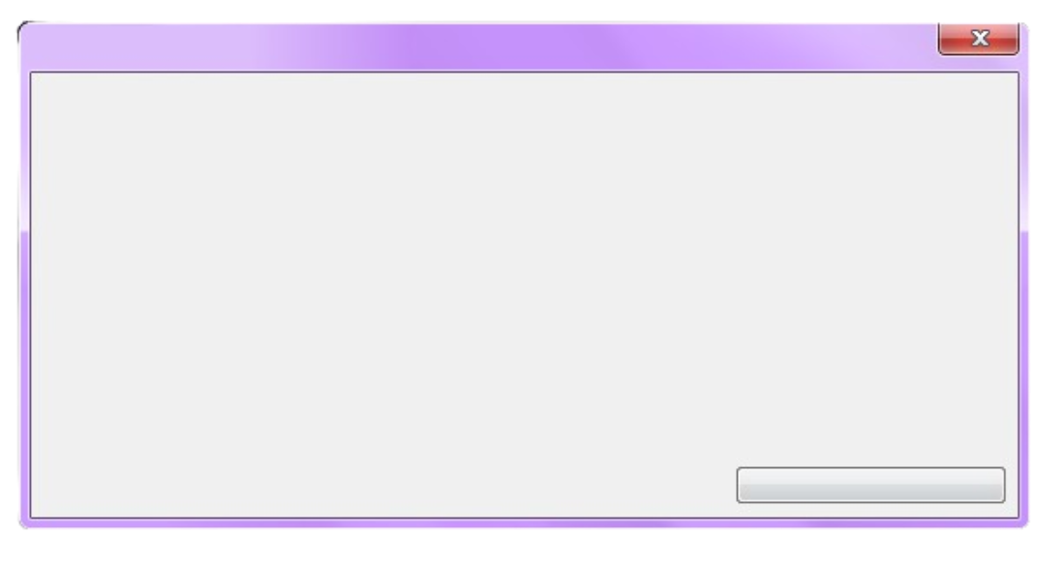
Introduction to the Project
"The best code is simple, elegant, and does exactly what it needs to do—nothing more, nothing less."
"The beauty of programming lies in solving impossible problems with just a keyboard and your mind."
Overview
print(“Hello, World!”)
The Stock Market Dashboard is a Streamlit-based web application that provides real-time stock data, interactive graphs, AI-powered insights, and educational resources. It allows users to analyze stock trends, compare stocks, calculate future profits/losses, and access learning materials—all in one user-friendly interface.
Cmt = input(“Enter Your Feedback : ”)
Problem_Addressed
continue
❌ Complex and hard-to-use stock platforms →
✅ Simple, beginner-friendly dashboard ❌ Lack of real-time insights for investors →
✅ Live stock data and AI-powered chatbot ❌ Difficult to estimate profit/loss →
✅ Built-in calculator for future predictions ❌ Limited educational resources →
✅ PDF library for stock market learning
print(Overview)
print(Problem_Addressed)
continue

Slide 4
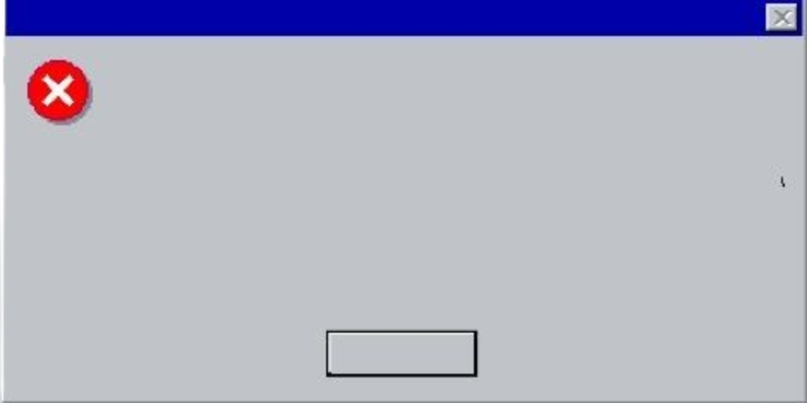



Goal / Purpose
"Every error you fix is a step closer to mastery."
"Don’t just write code; craft solutions that inspire."
Purpose
Goal
To provide a comprehensive yet easy-to-use platform for stock market analysis, predictions, and education, helping users make informed investment decisions.
🔹 Make stock market data accessible to everyone 🔹 Provide AI-driven insights for smarter investments 🔹 Offer a one-stop platform for stock analysis & learning
def greeting(name): print("Hello, " + name)
continue
continue
Main_Objectives
line = 8
i = 1
while i <= line:
j = 1
while j <= i:
print(j, end=" ")
j += 1
print()
i += 1
import mymodule mymodule.greeting(“Viewer")
To create a powerful yet simple dashboard that enables users to analyze stocks, make predictions, learn investment strategies, and receive AI-driven insights.
continue

Slide 5


Affected People
"Programming is the art of turning coffee into logic."
import random
while True:
rand_num = random.randint(1, 100)
print(rand_num)
if rand_num == 69:
break
Target Users
👨‍💻 Beginners & Investors – Learn and track stock trends 📊 Traders & Analysts – Analyze and compare stocks 📈 Business Enthusiasts – Make informed investment decisions
How It Helps
continue
✅ Provides real-time stock data & analysis ✅ Simplifies stock search & comparison ✅ Offers AI-driven investment suggestions ✅ Helps users calculate potential profit/loss ✅ Acts as an educational hub for beginners
import os
files = os.listdir(".")
with open("file_list.txt", "w") as file:
for f in files:
file.write(f + "\n")
continue

Slide 6










Functionalities
Key Features
🔹 Live Stock Data (Yahoo Finance / Alpha Vantage API) 🔹 Interactive Graphs (Matplotlib & Plotly) 🔹 Stock Comparison Tool 🔹 Profit/Loss Calculator 🔹 AI Chatbot for Stock Suggestions 🔹 Automated Email Alerts 🔹 PDF Library for Stock Market Learning
weight = get_positive_float("Enter your weight in kilograms: ") height_in_feet = get_positive_float("Enter your height in feet: ") height_in_meters = height_in_feet * 0.3048 # (1 foot = 0.3048 meters) bmi = weight / (height_in_meters ** 2) bmi = round(bmi, 2) if bmi < 18.5: category = "Underweight" elif 18.5 <= bmi < 24.9: category = "Normal weight" elif 25 <= bmi < 29.9: category = "Overweight" else: category = "Obesity" print(f"\nYour BMI is: {bmi}") print(f"You are categorized as: {category}") calculate_bmi()
def calculate_bmi():
def get_positive_float(cmd):
while True:
try:
value = float(input(cmd))
if value > 0:
return value
else:
print("Please enter a positive number.")
except:
print("Invalid input. Please enter a valid number.")
"Code is like humor—if you have to explain it, it’s not good enough."
continue

Slide 7



How to Use
Streamlit: Streamlit Python framework for quickly building interactive web apps without needing frontend development.
Step-by-Step Guide
Python is a high-level, interpreted programming language created by Guido van Rossum in 1991. Known for its simplicity and readability, Python supports multiple programming paradigms, including procedural, object-oriented, and functional programming. It is widely used in web development, data analysis, artificial intelligence, machine learning, automation, and more. With its extensive standard library, large community, and vast ecosystem of third-party libraries, Python has become a versatile and beginner-friendly language suitable for both small projects and large-scale applications.
Login/Register → Start by creating an account or logging in.
2.Visit the Website → Open the Streamlit dashboard
3.Search for a Stock → Enter stock symbol for live data
4.Analyze Trends → View graphs, historical data, and predictions
5.Use the Calculator → Estimate future profit/loss
6.Ask AI Chatbot → Get investment insights
7.Download PDFs → Access stock market learning materials
"Behind every successful program is a coder who never stopped debugging."
continue

Slide 8




Why My Project is the Best
My Stock Market Dashboard stands out because it combines simplicity, efficiency, and powerful insights to help users make informed investment decisions. Unlike other platforms, it not only provides real-time stock data and trend analysis but also features an AI-powered chatbot for stock suggestions and a profit/loss calculator to predict future outcomes.
With its user-friendly interface, interactive graphs, and educational PDF library, it caters to both beginners and experienced traders. The addition of automated email alerts ensures users never miss important market updates, making it a unique, practical, and efficient solution for stock market analysis. 🚀
AN Productions – Turning Ideas into Reality
"Programming isn’t about what you know; it’s about what you can figure out."
Innovation
Unique Features
"A good programmer writes code that humans can understand, not just machines."
⭐ AI Chatbot for real-time stock market insights ⭐ Automated Email Updates on stock market changes ⭐ Stock Market Learning Hub with educational PDFs ⭐ Interactive & Workable Graphs
🚀 Combines stock analysis + AI chatbot + learning resources in one place 🚀 Real-time data processing & prediction calculator 🚀 Integrated educational PDFs for beginner investors
continue
continue
Efficiency
User Friendliness
⚡ Optimized API calls for faster stock data updates ⚡ Smooth performance with Streamlit’s lightweight framework ⚡ User-friendly interface for quick stock analysis
✔️ Simple UI – Easy for beginners ✔️ No login required for basic access ✔️ Minimalist & clean design ✔️ Mobile-responsive for better accessibility
continue
continue

Slide 9
My Introduction
My name is Ahnaf Mahmud Towseem Ahan, and I am currently a student of Class 10 EV, Science Department at Willes Little Flower School and College. I have a strong interest in technology and programming, which has led me to pursue an ongoing Python Crash Course offered by the Songjog Foundation, taught by the highly skilled instructor Mushfiqur Ahmed Anik.
The inspiration for my project came from my friend, whose idea motivated me to tackle real-world problems through programming. To ensure its success, I conducted a thorough review of online resources to refine my approach. My goal is to make this project stand out by combining innovation, functionality, and a user-friendly experience for seamless stock market analysis. 🚀
“We are programmers, our first love is error.”
"Code is not just a set of instructions; it's a language where creativity meets logic to build the future."
I actively share my work on GitHub at ANAHAN07. You can also explore my instructor’s GitHub at Musfique-Ahmed for additional learning resources.
I am deeply passionate about applying my knowledge of Python to meaningful projects and continuously look for opportunities to turn my ideas into reality. For any correspondence,
you can reach me at ahnaftowseem2021@gmail.com or ahanclientservice@gmail.com.

